Slide 1
CSC 112: Computer Operating Systems Lecture 6 Real-Time Scheduling Exercises ANS
Department of Computer Science,
Hofstra University

Slide 2
Q1. Schedulability under RM or EDF
Determine schedulability of the following tasksets under (1) RM scheduling, using use Utilization Bound test and/or Response Time Analysis (RTA) to determine taskset schedulability. (2) EDF scheduling, using Utilization Bound test (the RM Utilization Bounds are provided in the following table). We use the notation τi (Ci, Ti, Di) to denote task τi with WCET Ci Period Ti, Deadline Di (c.f. Slide 33 in Lecture 6)
1) Taskset τ1 (3, 6, 6), τ2 (4, 9, 9)
2) Taskset τ1 (3, 6, 6), τ2 (3, 9, 9)
3) Taskset τ1 (3, 6, 6), τ2 (2, 9, 9)
4) Taskset τ1 (2, 4, 4), τ2 (4, 8, 8)
# Tasks | RM Util Bound
1 | 1.00
2 | 0.828
3 | 0.780

Slide 3
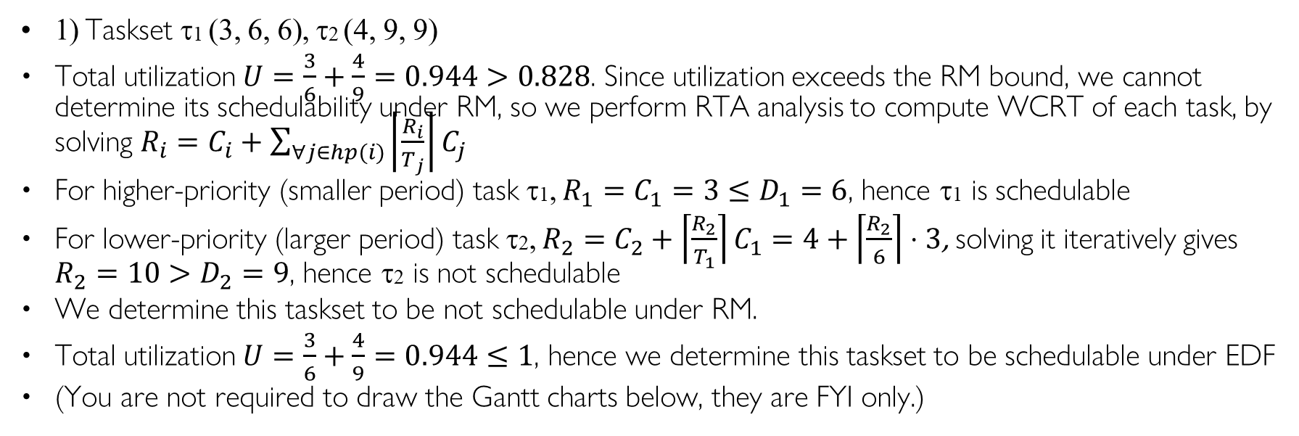
Q1. Schedulability under RM or EDF ANS
1) Taskset τ1 (3, 6, 6), τ2 (4, 9, 9)
Total utilization $U=\frac{3}{6}+\frac{4}{9}=0.944>0.828$. Since utilization exceeds the RM bound, we cannot determine its schedulability under RM, so we perform RTA analysis to compute WCRT of each task, by solving $R_{i}=C_{i}+\sum_{∀j∈hp(i)}{\left\lceil \frac{R_{i}}{T_{j}}\right\rceil C_{j}}$
For higher-priority (smaller period) task τ1, $R_{1}=C_{1}=3≤D_{1}=6$, hence τ1 is schedulable
For lower-priority (larger period) task τ2, $R_{2}=C_{2}+\left\lceil \frac{R_{2}}{T_{1}}\right\rceil C_{1}=4+\left\lceil \frac{R_{2}}{6}\right\rceil ⋅3$, solving it iteratively gives $R_{2}=10>D_{2}=9$, hence τ2 is not schedulable
We determine this taskset to be not schedulable under RM.
Total utilization $U=\frac{3}{6}+\frac{4}{9}=0.944≤1$, hence we determine this taskset to be schedulable under EDF
(You are not required to draw the Gantt charts below, they are FYI only.)
τ1
τ1
0
3
6
9
12
15
18
0
3
6
9
12
15
18
τ2
τ2
0
3
6
9
12
15
18
0
3
6
9
12
15
18
deadline miss
Gantt chart for RM
Gantt chart for EDF

Slide 4
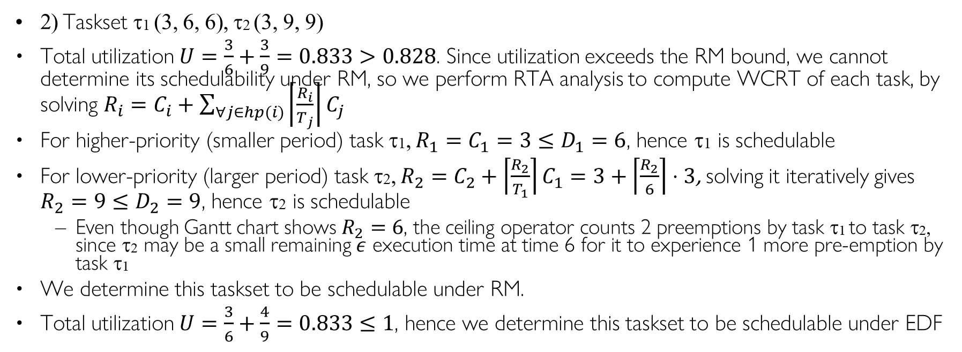
Q1. Schedulability under RM or EDF ANS
2) Taskset τ1 (3, 6, 6), τ2 (3, 9, 9)
Total utilization $U=\frac{3}{6}+\frac{3}{9}=0.833>0.828$. Since utilization exceeds the RM bound, we cannot determine its schedulability under RM, so we perform RTA analysis to compute WCRT of each task, by solving $R_{i}=C_{i}+\sum_{∀j∈hp(i)}{\left\lceil \frac{R_{i}}{T_{j}}\right\rceil C_{j}}$
For higher-priority (smaller period) task τ1, $R_{1}=C_{1}=3≤D_{1}=6$, hence τ1 is schedulable
For lower-priority (larger period) task τ2, $R_{2}=C_{2}+\left\lceil \frac{R_{2}}{T_{1}}\right\rceil C_{1}=3+\left\lceil \frac{R_{2}}{6}\right\rceil ⋅3$, solving it iteratively gives $R_{2}=9≤D_{2}=9$, hence τ2 is schedulable
Even though Gantt chart shows $R_{2}=6$, the ceiling operator counts 2 preemptions by task τ1 to task τ2, since τ2 may be a small remaining $ε$ execution time at time 6 for it to experience 1 more pre-emption by task τ1
We determine this taskset to be schedulable under RM.
Total utilization $U=\frac{3}{6}+\frac{4}{9}=0.833≤1$, hence we determine this taskset to be schedulable under EDF
τ1
τ1
0
3
6
9
12
15
18
0
3
6
9
12
15
18
τ2
τ2
0
3
6
9
12
15
18
0
3
6
9
12
15
18
Gantt chart for RM
Gantt chart for EDF (same as RM)

Slide 5
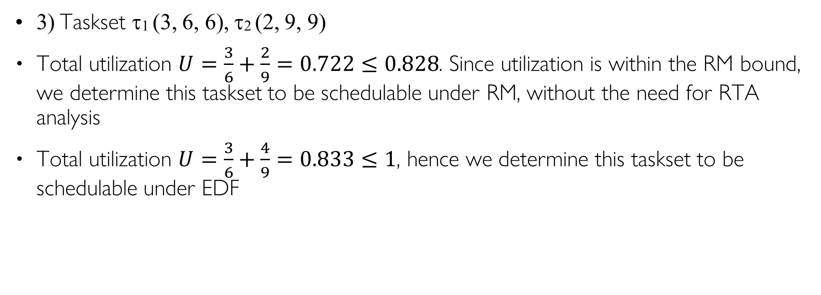
Q1. Schedulability under RM or EDF ANS
3) Taskset τ1 (3, 6, 6), τ2 (2, 9, 9)
Total utilization $U=\frac{3}{6}+\frac{2}{9}=0.722≤0.828$. Since utilization is within the RM bound, we determine this taskset to be schedulable under RM, without the need for RTA analysis
Total utilization $U=\frac{3}{6}+\frac{4}{9}=0.833≤1$, hence we determine this taskset to be schedulable under EDF
τ1
τ1
0
3
6
9
12
15
18
0
3
6
9
12
15
18
τ2
τ2
0
3
6
9
12
15
18
0
3
6
9
12
15
18
Gantt chart for RM
Gantt chart for EDF (same as RM)

Slide 6
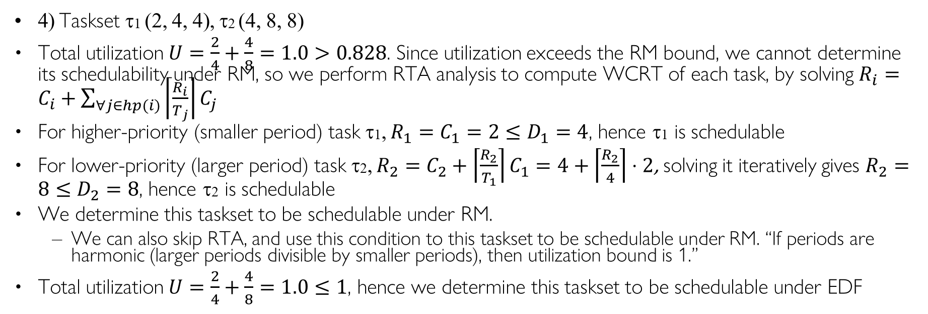
Q1. Schedulability under RM or EDF ANS
4) Taskset τ1 (2, 4, 4), τ2 (4, 8, 8)
Total utilization $U=\frac{2}{4}+\frac{4}{8}=1.0>0.828$. Since utilization exceeds the RM bound, we cannot determine its schedulability under RM, so we perform RTA analysis to compute WCRT of each task, by solving $R_{i}=C_{i}+\sum_{∀j∈hp(i)}{\left\lceil \frac{R_{i}}{T_{j}}\right\rceil C_{j}}$
For higher-priority (smaller period) task τ1, $R_{1}=C_{1}=2≤D_{1}=4$, hence τ1 is schedulable
For lower-priority (larger period) task τ2, $R_{2}=C_{2}+\left\lceil \frac{R_{2}}{T_{1}}\right\rceil C_{1}=4+\left\lceil \frac{R_{2}}{4}\right\rceil ⋅2$, solving it iteratively gives $R_{2}=8≤D_{2}=8$, hence τ2 is schedulable
We determine this taskset to be schedulable under RM.
We can also skip RTA, and use this condition to this taskset to be schedulable under RM. “If periods are harmonic (larger periods divisible by smaller periods), then utilization bound is 1.”
Total utilization $U=\frac{2}{4}+\frac{4}{8}=1.0≤1$, hence we determine this taskset to be schedulable under EDF
τ1
τ1
0
4
8
12
16
0
4
8
12
16
τ2
τ2
0
4
8
12
16
0
4
8
12
16
Gantt chart for RM
Gantt chart for EDF (same as RM)

Slide 7
Q2 RM, EDF, LLF
Consider the set of 2 periodic tasks whose period, deadline and WCET parameters are given.
1. For each scheduling algorithm (RM, EDF, LLF), draw the Gantt chart by filling in the table with the task ID that runs in each time slot until time 10, and calculate the WCRT for each task.
2. Under RM scheduling, use utilization bound and Response Time Analysis (RTA) to determine taskset schedulability.
Time | τ₁ Laxity | τ₂ Laxity | Running Task
t=0
t=1
t=2
t=3
t=4
t=5
t=6
t=7
t=8
T=9
Task ID | T=D | C | RM Resp. Time | EDF Resp. Time | LLF Resp. Time
1 | 8 | 3
2 | 10 | 4
RM
EDF
LLF
Time | 0 | 1 | 2 | 3 | 4 | 5 | 6 | 7 | 8 | 9 | 10
Gantt Chart

Slide 8
Q2 RM, EDF, LLF ANS
Consider the set of 2 periodic tasks whose period, deadline and WCET parameters are given.
1. For each scheduling algorithm (RM, EDF, LLF), draw the Gantt chart by filling in the table with the task ID that runs in each time slot until time 10, and calculate the WCRT for each task.
2. Under RM scheduling, determine taskset schedulability using utilization bound and/or Response Time Analysis (RTA) to
Time | τ₁ Laxity | τ₂ Laxity | Running Task
t=0 | 8-0-3=5 | 10-0-4=6 | 1
t=1 | 8-1-2=5 | 10-1-4=5 | 1 (tie)
t=2 | 8-2-1=5 | 10-2-4=4 | 2
t=3 | 8-3-1=4 | 10-3-3=4 | 2 (tie)
t=4 | 8-4-1=3 | 10-4-2=4 | 1
t=5 | T1 done | 10-5-2=3 | 2
t=6 | T1 done | 10-6-1=3 | 2
t=7 | T1 done | T2 done | X
t=8 | 16-8-3=5 | T2 done | 1
T=9 | 16-9-2=5 | T2 done | 1
Task ID | T=D | C | RM Resp. Time | EDF Resp. Time | LLF Resp. Time
1 | 8 | 3 | 3 | 3 | 5
2 | 10 | 4 | 7 | 7 | 7
RM | 1 | 1 | 1 | 2 | 2 | 2 | 2 | X | 1 | 1
EDF | 1 | 1 | 1 | 2 | 2 | 2 | 2 | X | 1 | 1
LLF | 1 | 1 | 2 | 2 | 1 | 2 | 2 | X | 1 | 1
Time | 0 | 1 | 2 | 3 | 4 | 5 | 6 | 7 | 8 | 9 | 10
Gantt Chart

Slide 9
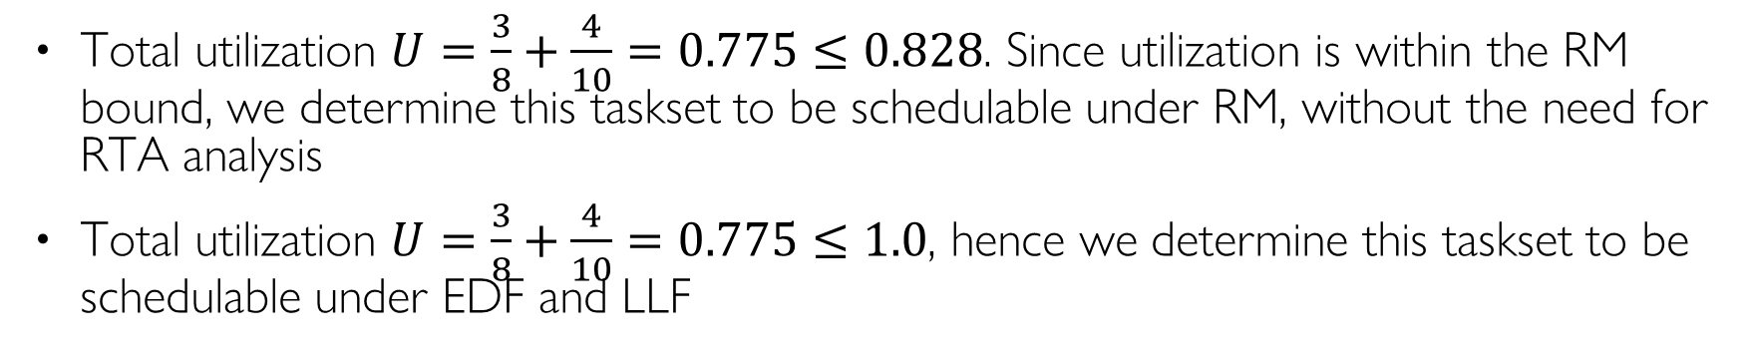
Q2 RM, EDF, LLF ANS
Total utilization $U=\frac{3}{8}+\frac{4}{10}=0.775≤0.828$. Since utilization is within the RM bound, we determine this taskset to be schedulable under RM, without the need for RTA analysis
Total utilization $U=\frac{3}{8}+\frac{4}{10}=0.775≤1.0$, hence we determine this taskset to be schedulable under EDF and LLF

